Slide 1
Simulating Hyper-Eddington accretion at the vicinity of black hole seed
Haojie Hu
DoA, KIAA, Peking U

Slide 2
Outlines
SMBHs at high-z
Accretion from Bondi scale
Hyper-Eddington accretion near the seed BHs
Conclusions and prospects

Slide 3
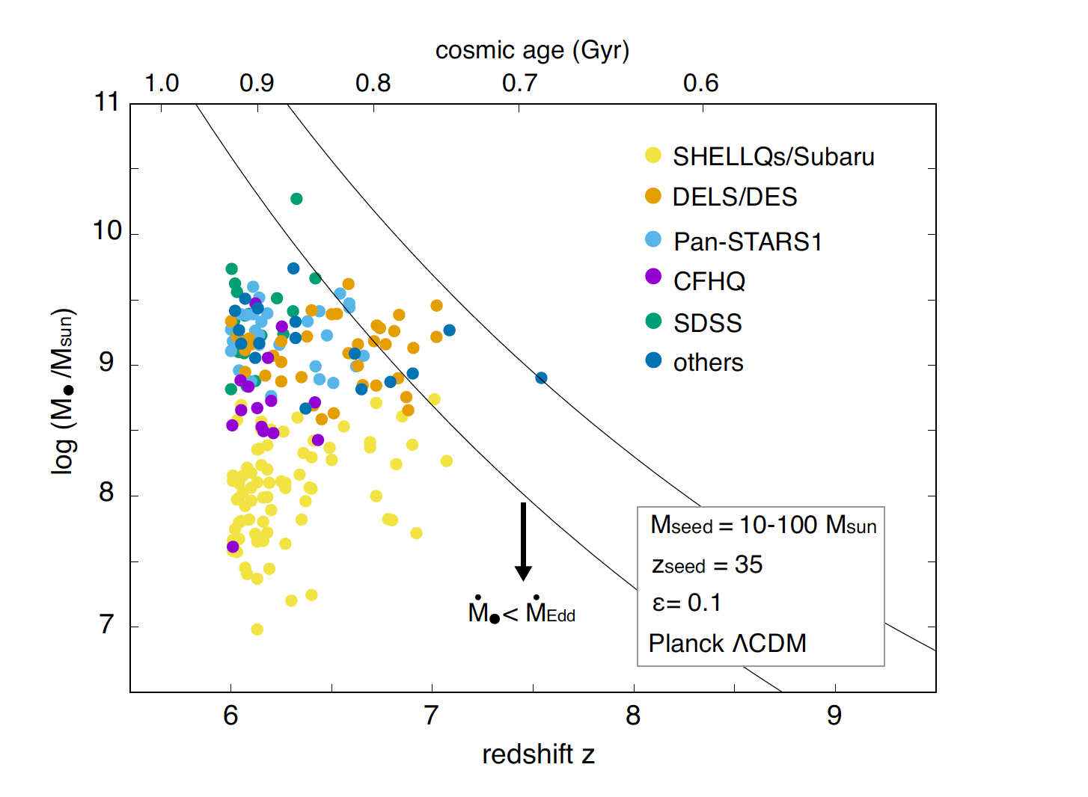
High-z SMBHs
Inayoshi et al. A&A (2020)
Notes:
200 quasars,

Slide 4
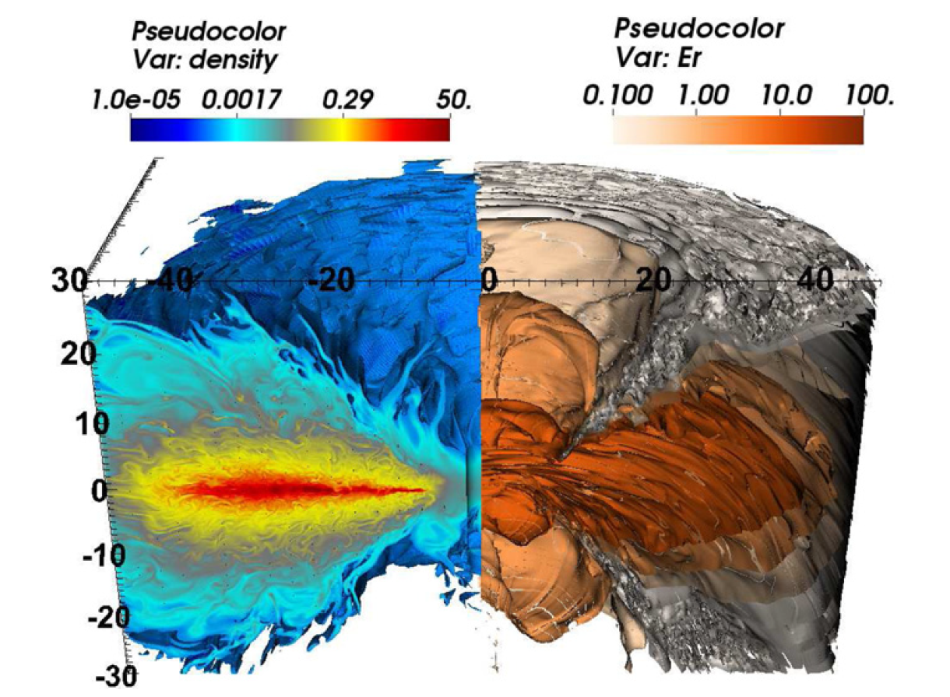
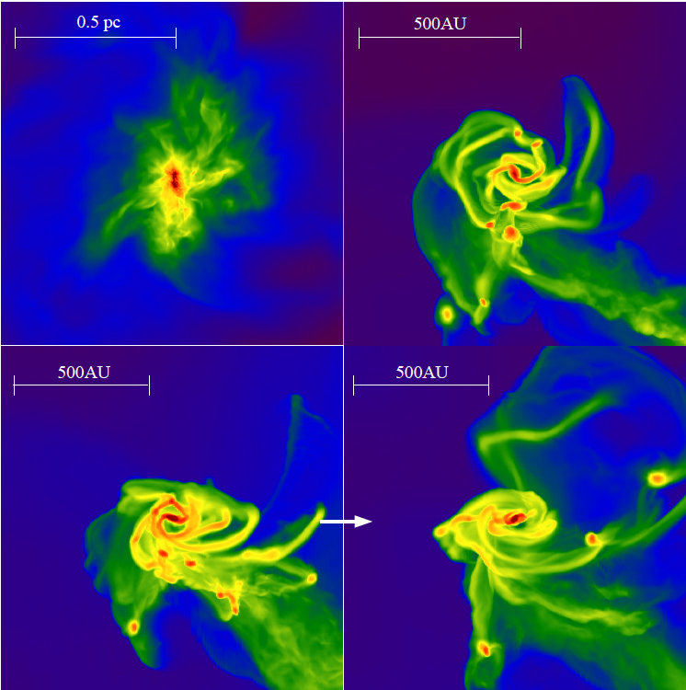
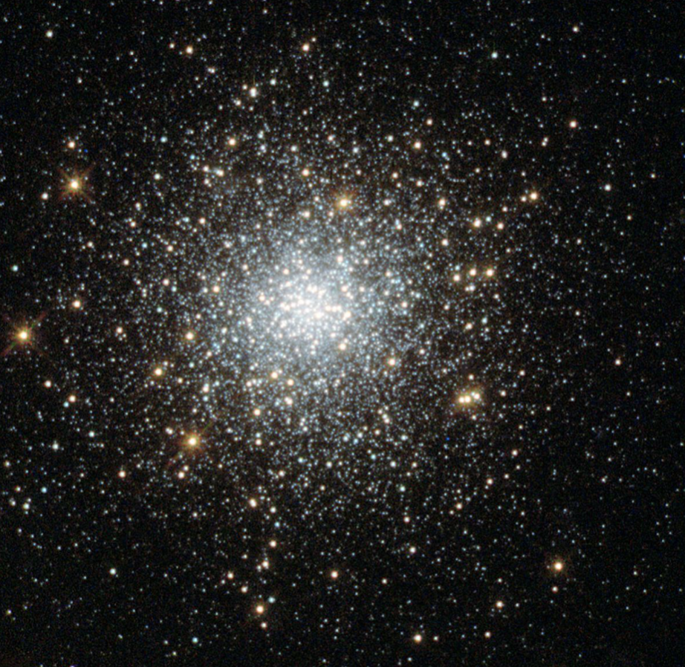
Formation of heavy seed BHs
Hyper-Eddington accretion
Jiang et al. (2014)
DCBH
Regan et al. (2014)
Rapid merger
Runaway collisions
Dense stellar cluster
Notes:
1, hyper eddington accretion(highlight)
2, DCBH: high baryon-DM streaming velocity
3, runaway collision in dense cluster.

Slide 5
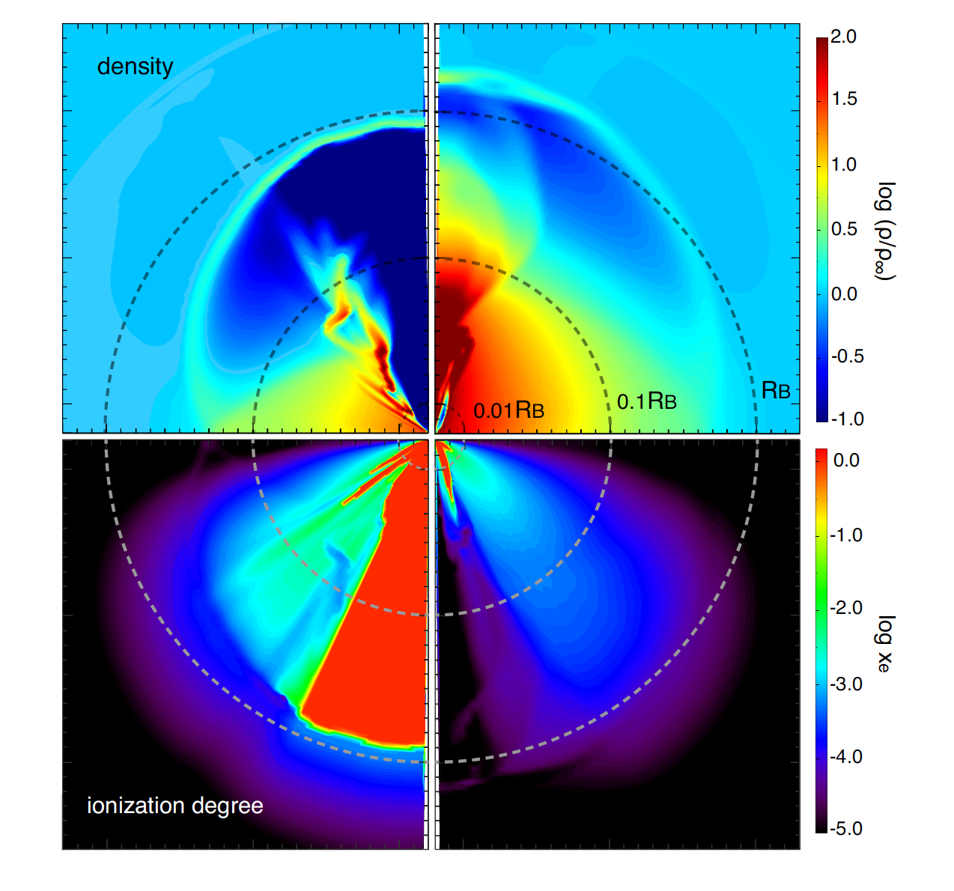
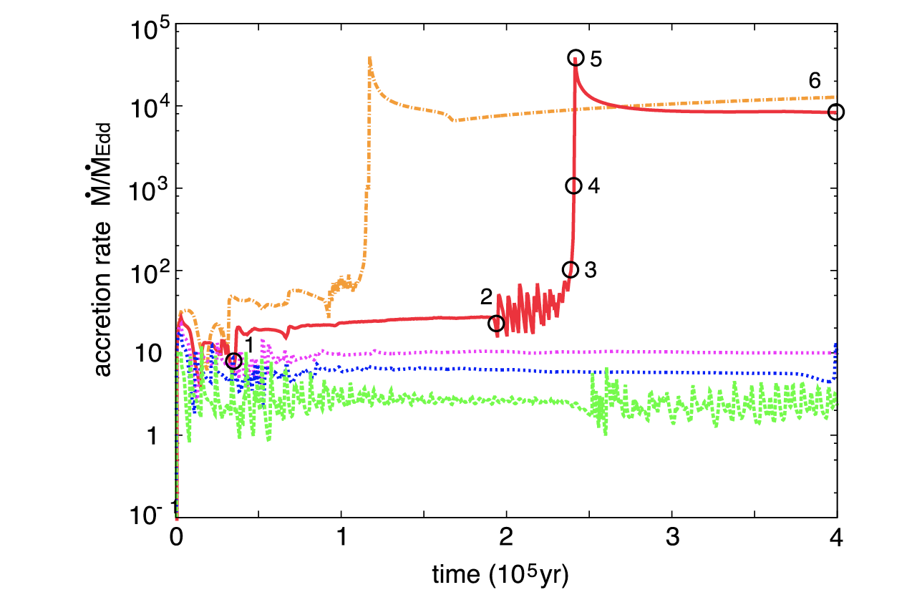
Accretion at large scale
Takeo et al. (2018)
Inayoshi et al. (2016)
Hyper-Eddington accretion
(from larger scales)
Notes:
Left: transition from Eddington to Hyper-Eddington.
Right: Hyper Eddington accretion.
with the primordial gas composition, the quasi-steady super-Eddington accretion on to a BH is realized when the Bondi radius is larger than the typical size of an HII bubble created around the BH.
If R_HII > R_B, The radiation heating and pressure can affect the gas dynamics at the Bondi radius. Thus, the accretion is suppressed. In the other case, the accretion from the Bondi radius cannot halt due to radiation feedback, and the accretion flow becomes steady with high mdot. (Bondi accretion rate is 7200)

Slide 6
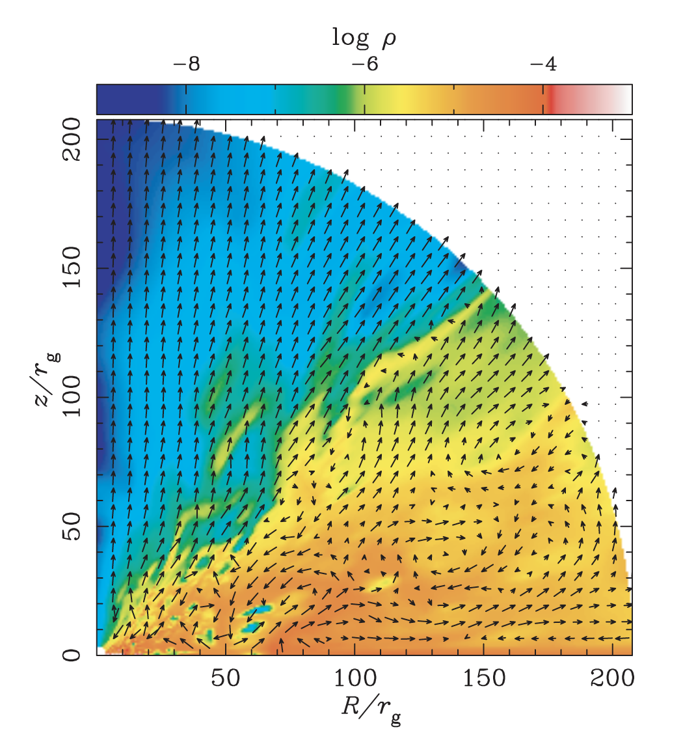
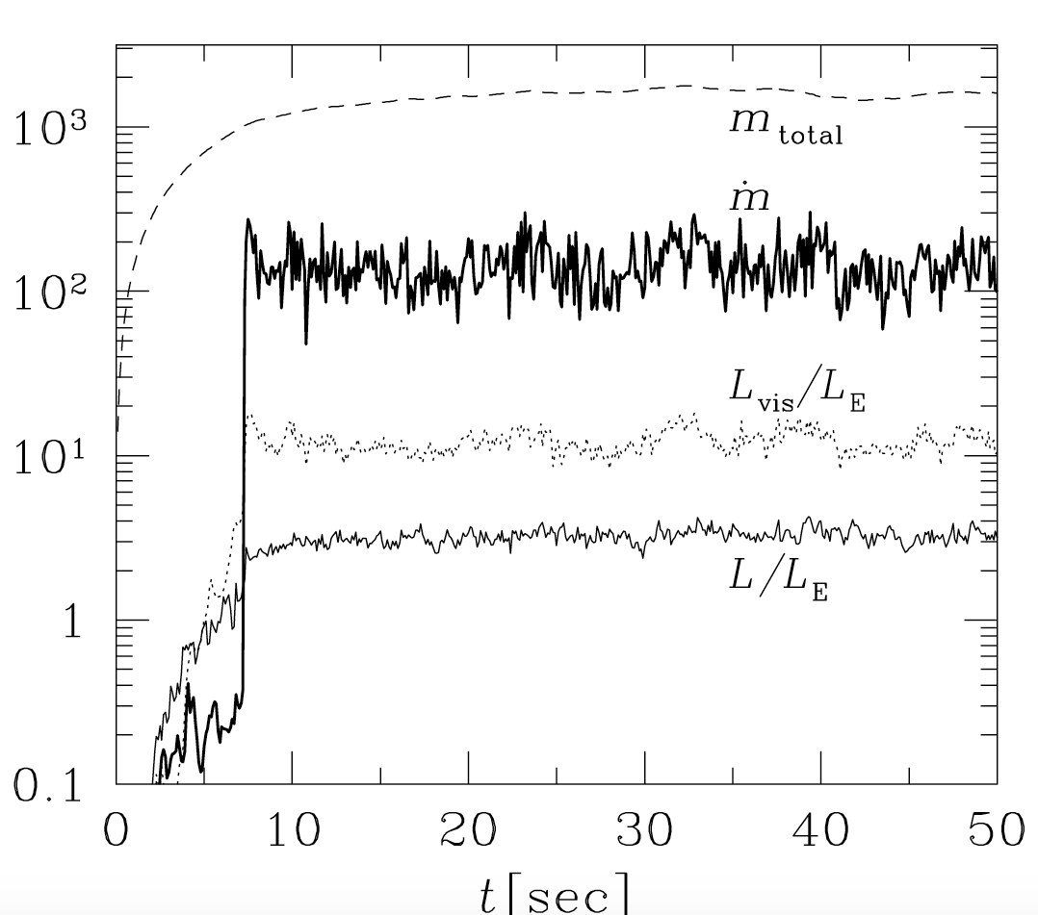
Hyper-Eddington accretion near the BH
Ohsuga et al. 2005
Hyper-Eddington accretion near BH
Notes:
Boundary condition: (1) two parts (>0.45pi ) & (<0.45pi). matter is continuously injected into the computational domain. We set the injected mass accretion rate 300, 1000, and 3000.
Timescale, boundary conditions, box domain.

Slide 7
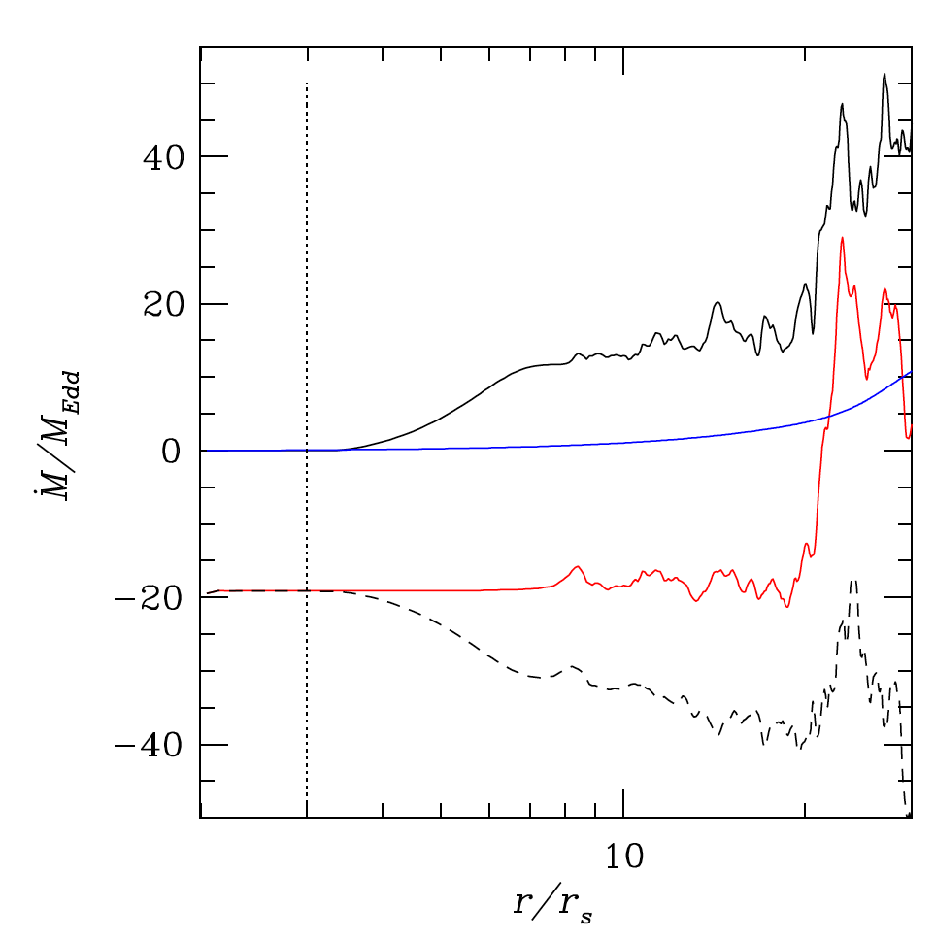
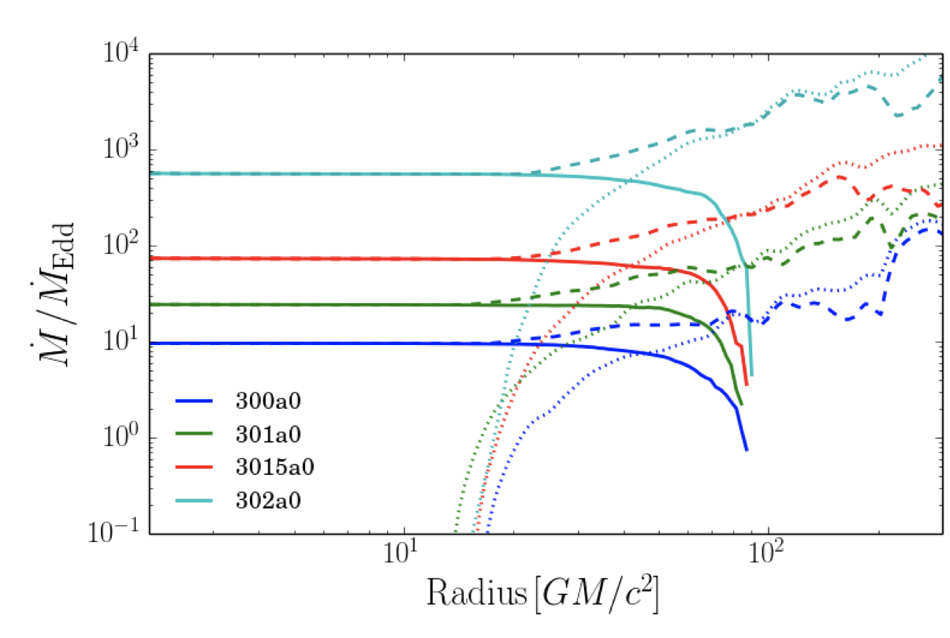
Hyper-Eddington accretion near the BH
Jiang et al. (2014)
Sadowski et al. (2016)
outflow
inflow
Inner region: Hyper-Eddington accretion
Outer region: Strong outflows
Gas supplement?
Notes:
Left: dash line: inflow, dotted line: outflow, solid line: net; color: entropy parameter(density).
Right: red line: net flow.
Boundary: allow outflow, no injection
Strong inflows, also outflows
Sadowski: 0.1 dynamical at R_max
Jiang: 0.01 dynamical timescale at R_max.

Slide 8
Hyper-Eddington accretion near the BH
accretion near the BH(but not at the outer boundary)
photon-trapping effect(RMHD): highly anisotropic
2-D & 3-D
Motivation:
A gap between the small scale accretion & Bondi accretion.
Gas supplement at the outer radius.
Inside the trapping radius, is gas really accreted at the inner radius?
What is the effect of boundary?
Notes:
Boundary conditions: 1) zero-gradient boundary condition, 2)inflow boundary conditions(not yet), 3) a density torus like in Jiang’s paper.
Density normalization, how to set mdot(inject mass)

Slide 9
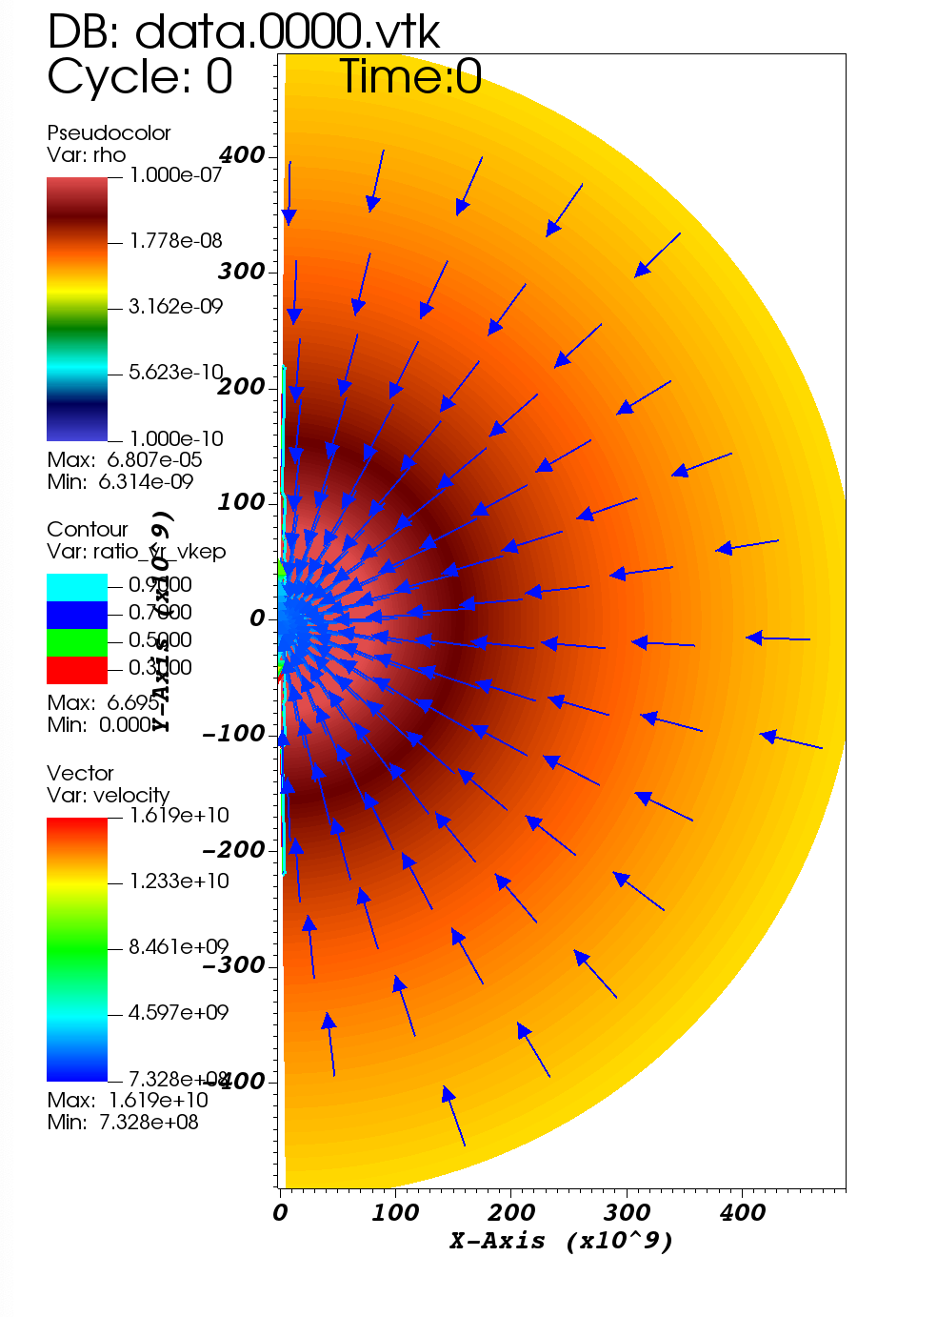
Hyper-Eddington accretion near the BH
Simulation setup
Optically thick, P_rad dominates
Box size:
Adiabatic index:
BH mass:
Initial condition: Bondi profile
Angular momentum:
Notes:
Boundary conditions: 1) zero-gradient boundary condition, 2)inflow boundary conditions(not yet)
High density medium,
Optical thick, tau is >>1, radiation dominated, so gamma 4/3 is a good approximation.
Goal: gas motion in the long time(several dynamical timescale inner) and large scale,

Slide 10
Hyper-Eddington accretion near the BH
Hot bubble expands
Bubble touches the outer radius
Gas starts to contract
Convection occurs

Slide 11
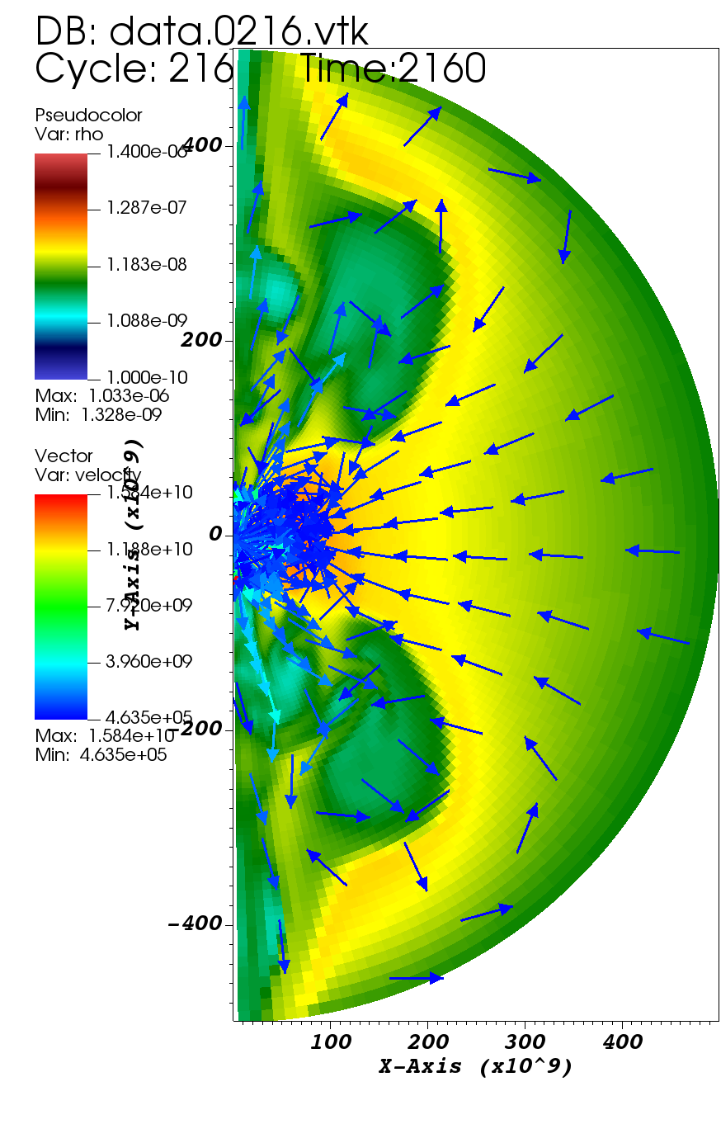
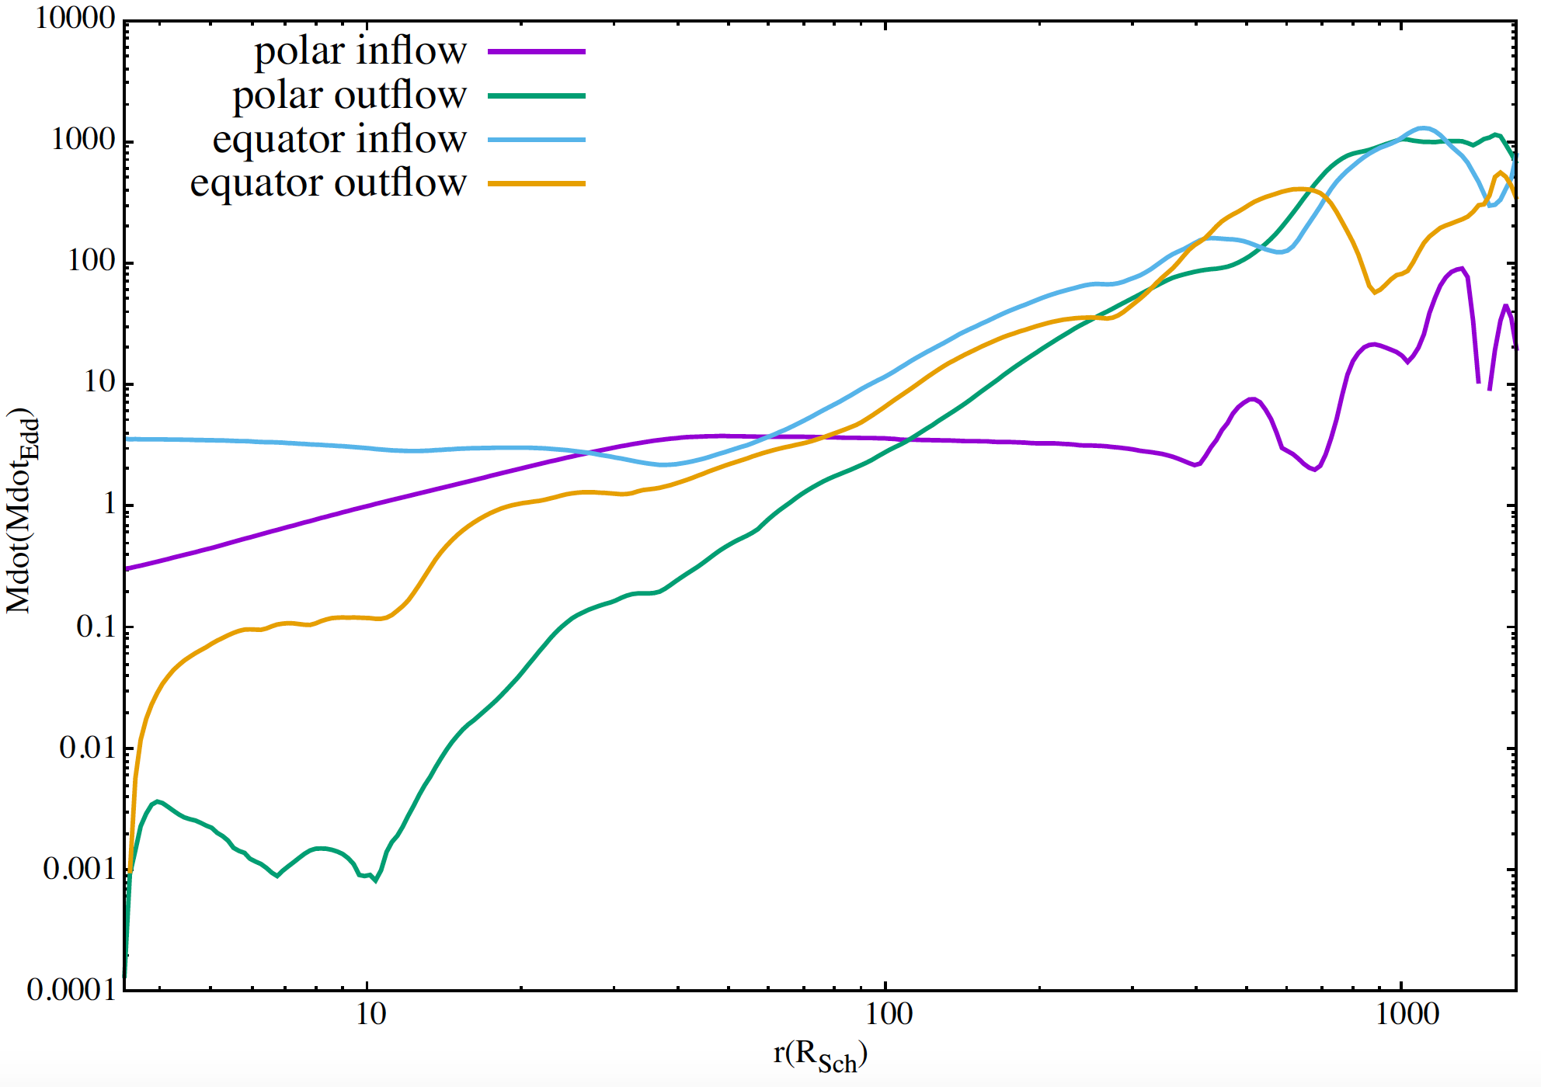
Mass flow at different region
10
0.01
10
1000
Inner: Several Eddington accretion
Large scale: strong outflows
Notes:
Most of the gas is accreted along the equator.

Slide 12
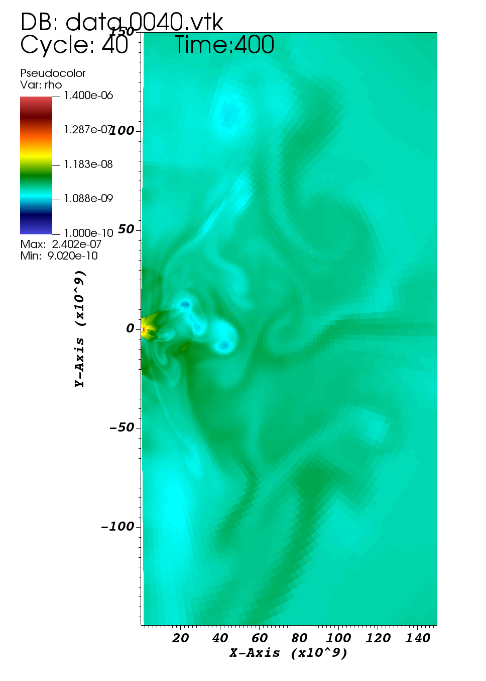
Convection and outflows
Adiabatic gas
(very optically thick)
Entropy gradient
Violent convection
Suppression of inflows /
Outflows towards to poles
Notes:
Violent convection drives the outflows

Slide 13
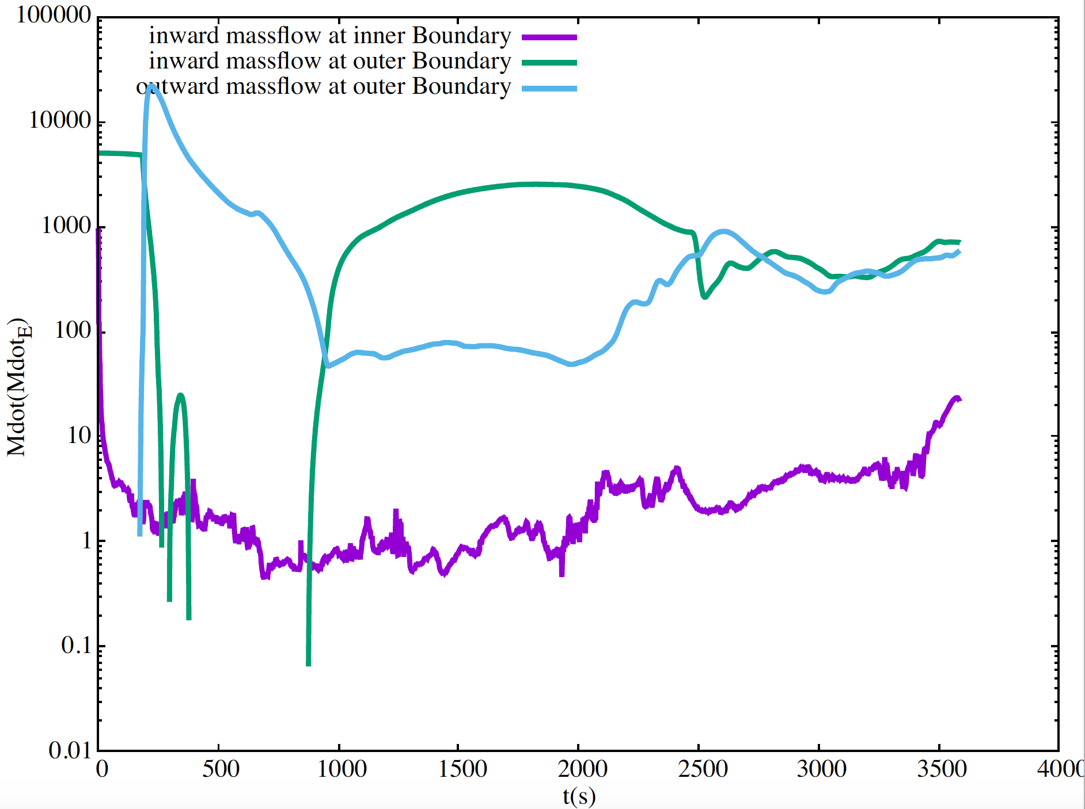
Evolution of inflow/outflow rates
1000
10
0.1
1000
3000
Outer radius: High accretion rate
Inner radius: Several Eddington accretion rate

Slide 14
Conclusions
In the simulation, even if we have large accretion rate in the outer boundary, the accretion to the black hole is limited to Eddington accretion rate.
Prospects
Boundary condition: mass inject condition, or others
Box domain: Connect the Bondi accretion to the accretion near the BHs.
2D→3D, GR correction.
What about the influence of bulge of galaxies.

